Slide 1


Weekly Report NTUA 21/2/2020
George Bakas

Slide 2
Status Report
Analysis:
Efficiency and Acceptance:
Parton and Particle
Nominal MC samples
mTT samples have now corrected xsec
2017 and 2018 we use only the 100—Inf file
MC ‘16 , ‘17, ’18 Comparison:
All Slices Comparison
Mtt slice comparison for 16/17 and 17/18
Nominal MC per slice comparison for 17/18
NTUA HEP Site
HEP Data

Slide 3
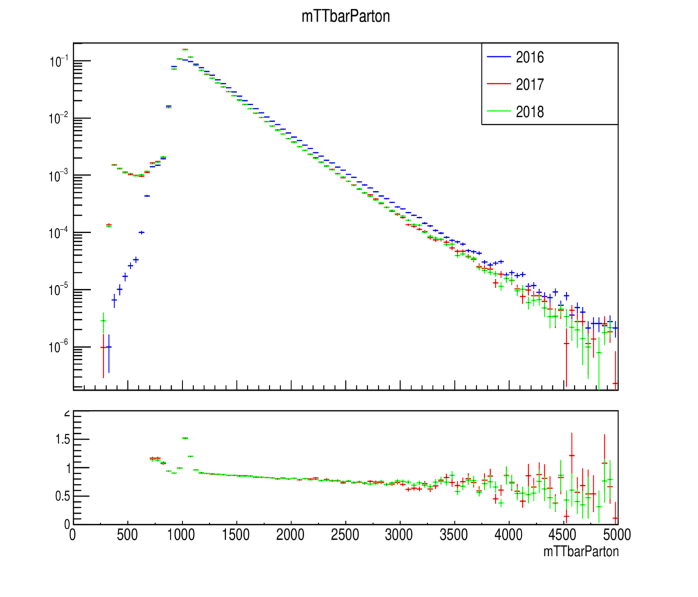
MC Closure tests ’16, ‘17 and ’18 (shape) for mtt files

Slide 4
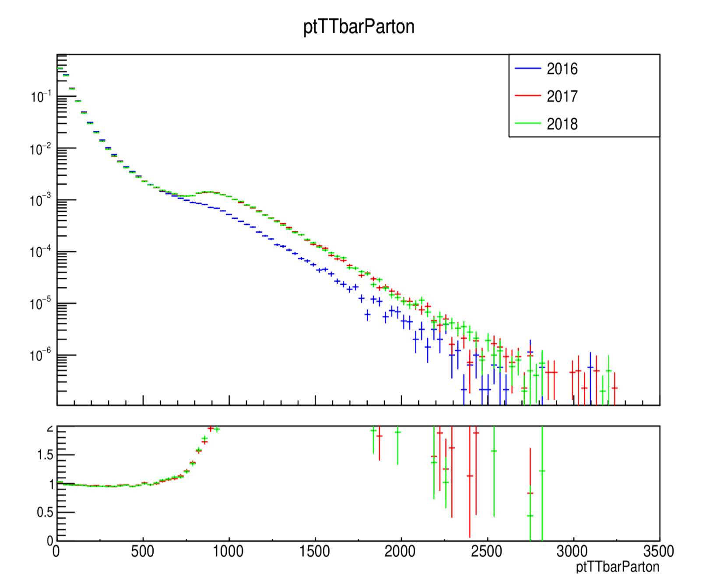
MC Closure tests ’16, ‘17 and ’18 (shape) for mtt files

Slide 5
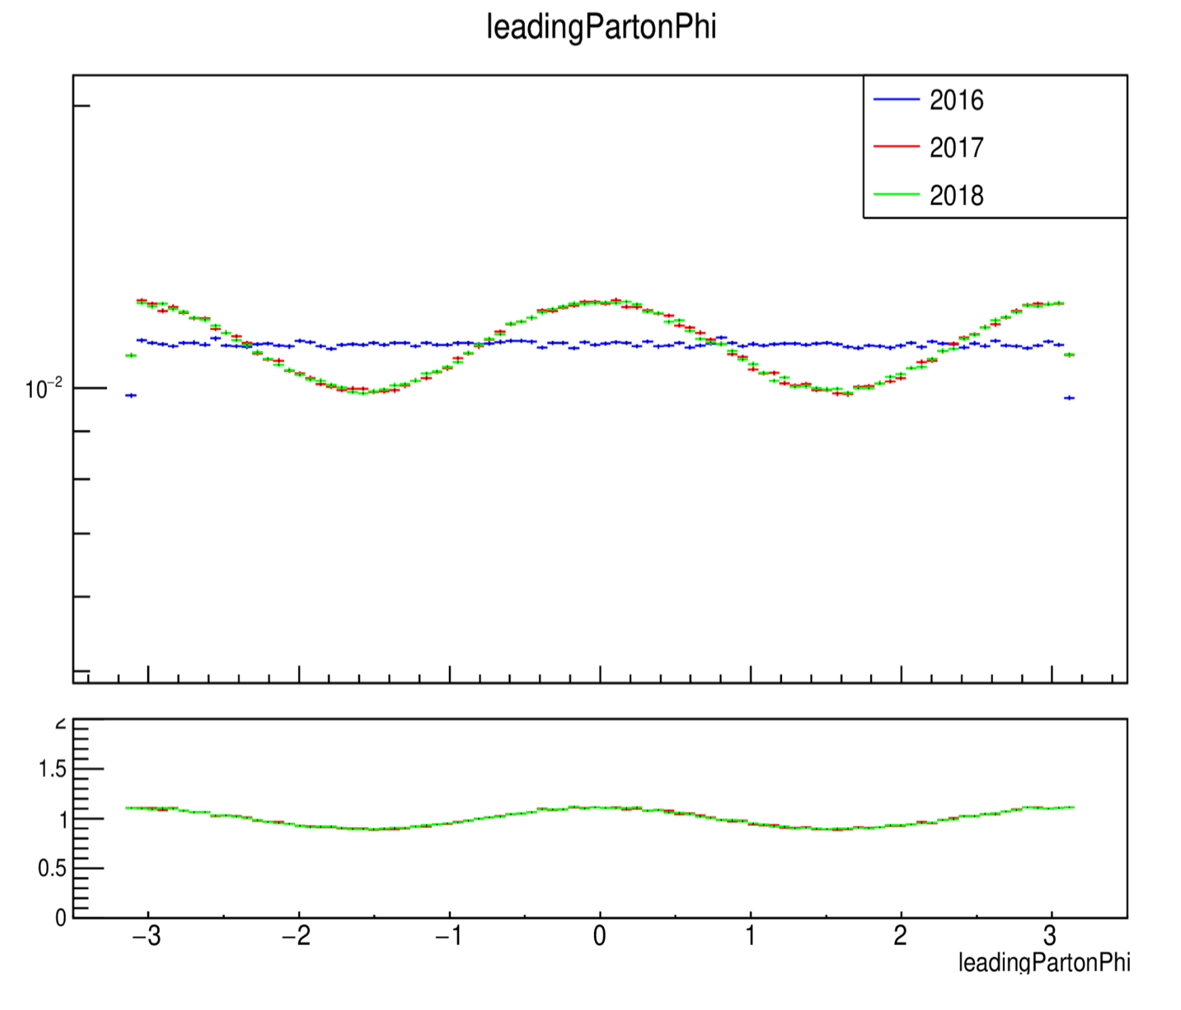
MC Closure tests ’16, ‘17 and ’18 (shape) for mtt files

Slide 6
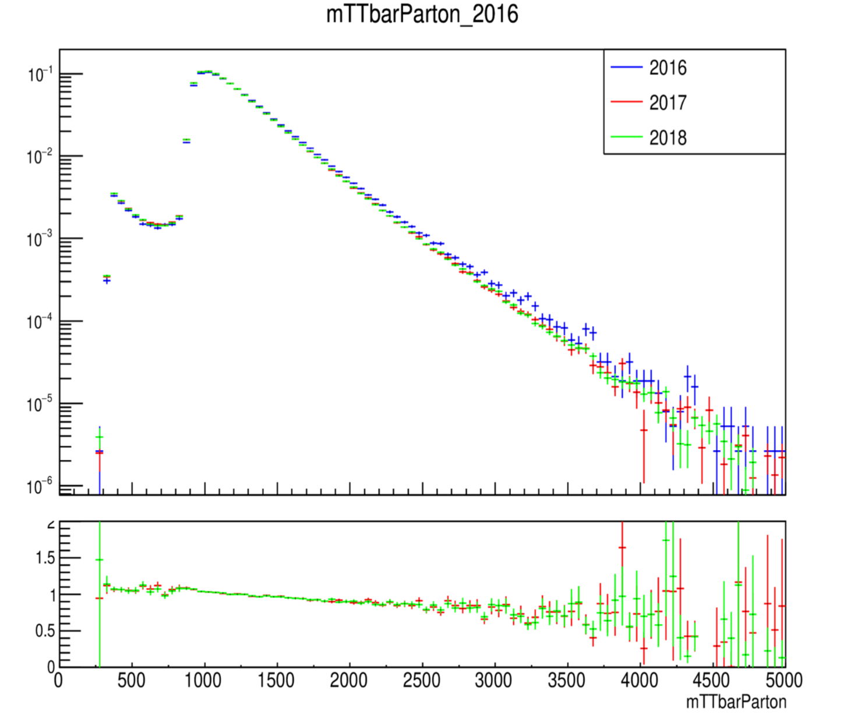
MC Closure tests ’16, ‘17 and ’18 (shape) nominal

Slide 7
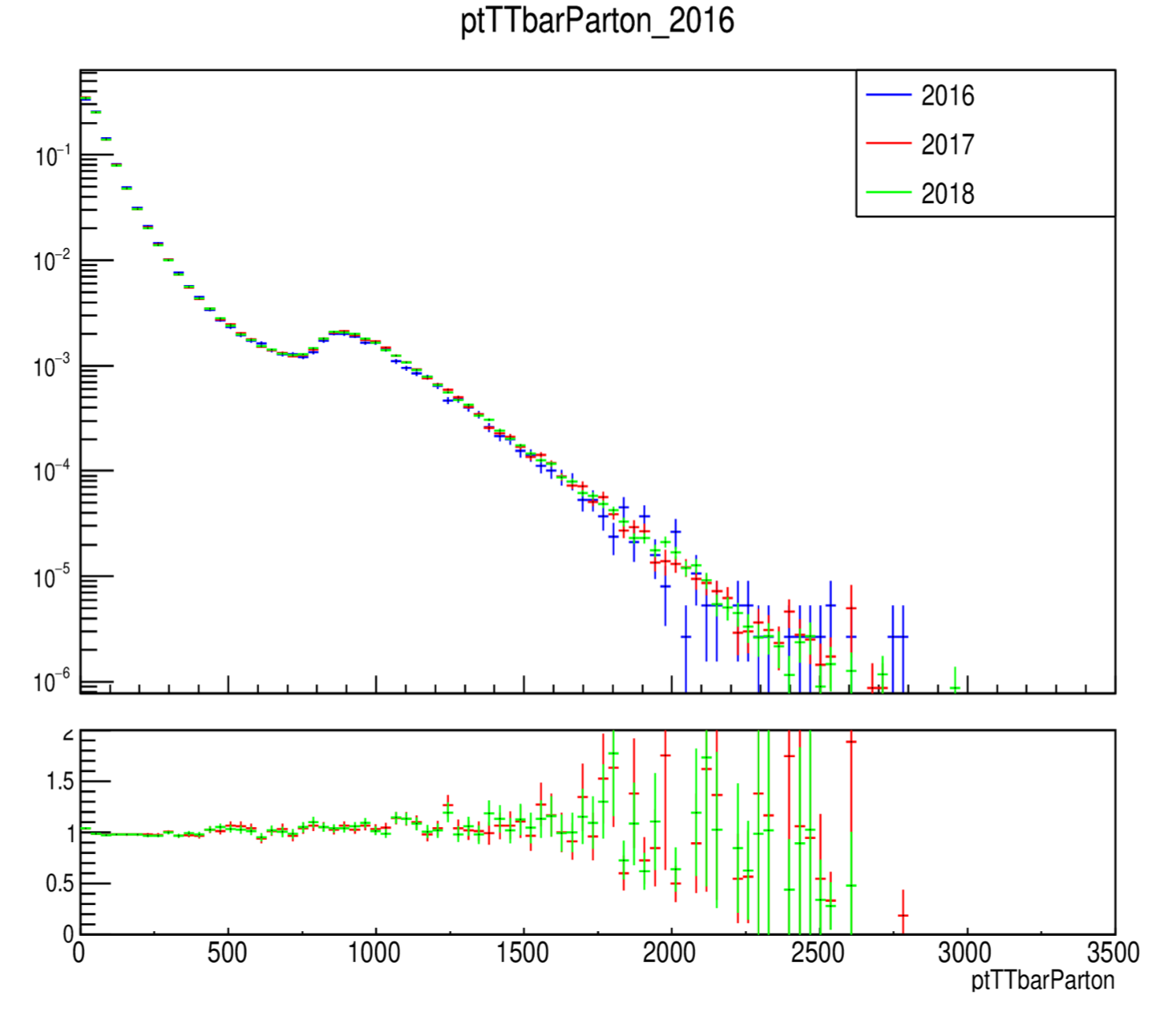
MC Closure tests ’16, ‘17 and ’18 (shape) nominal

Slide 8
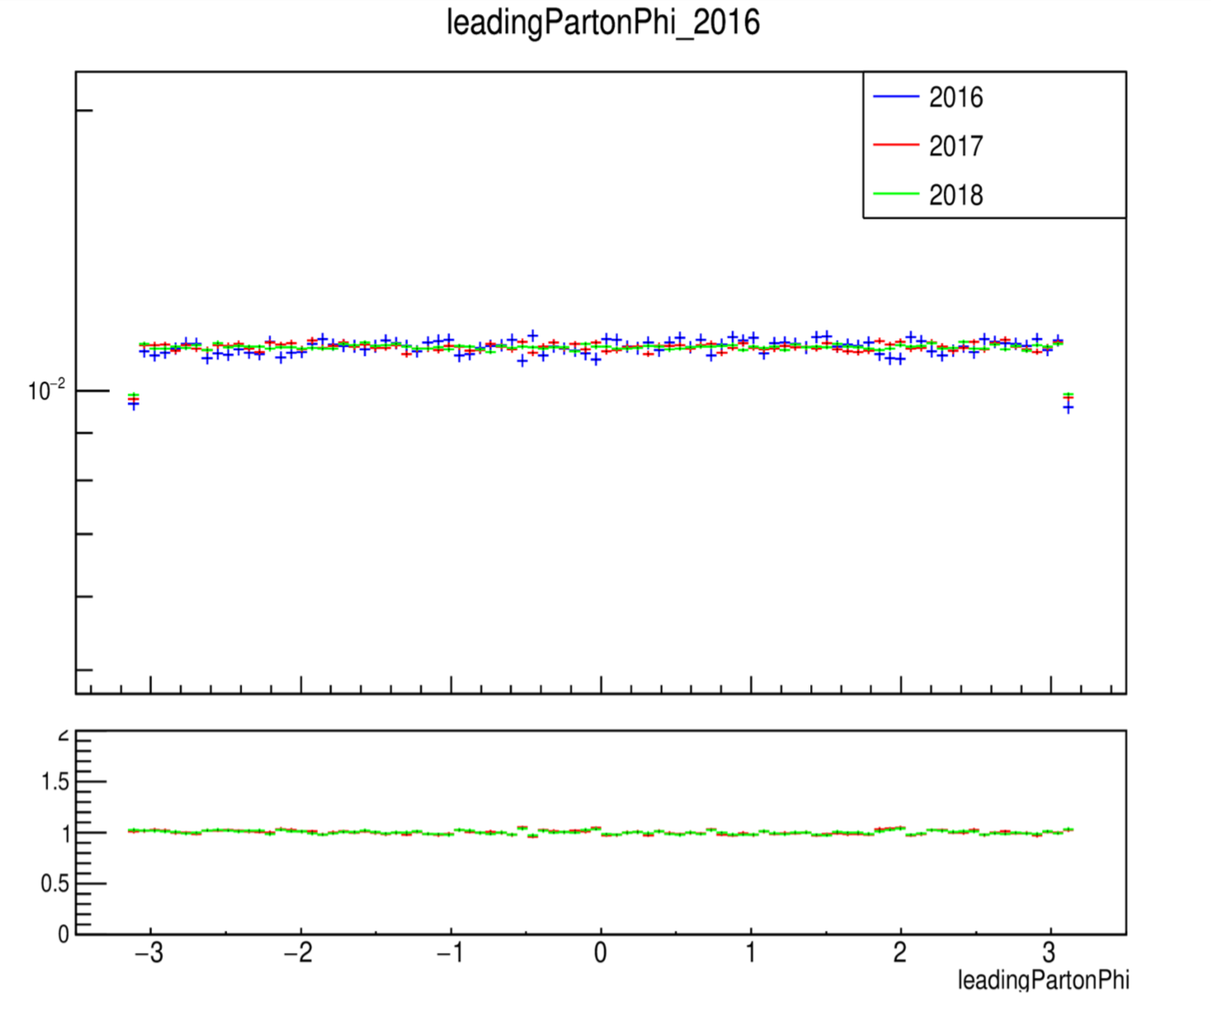
MC Closure tests ’16, ‘17 and ’18 (shape) nominal

Slide 9
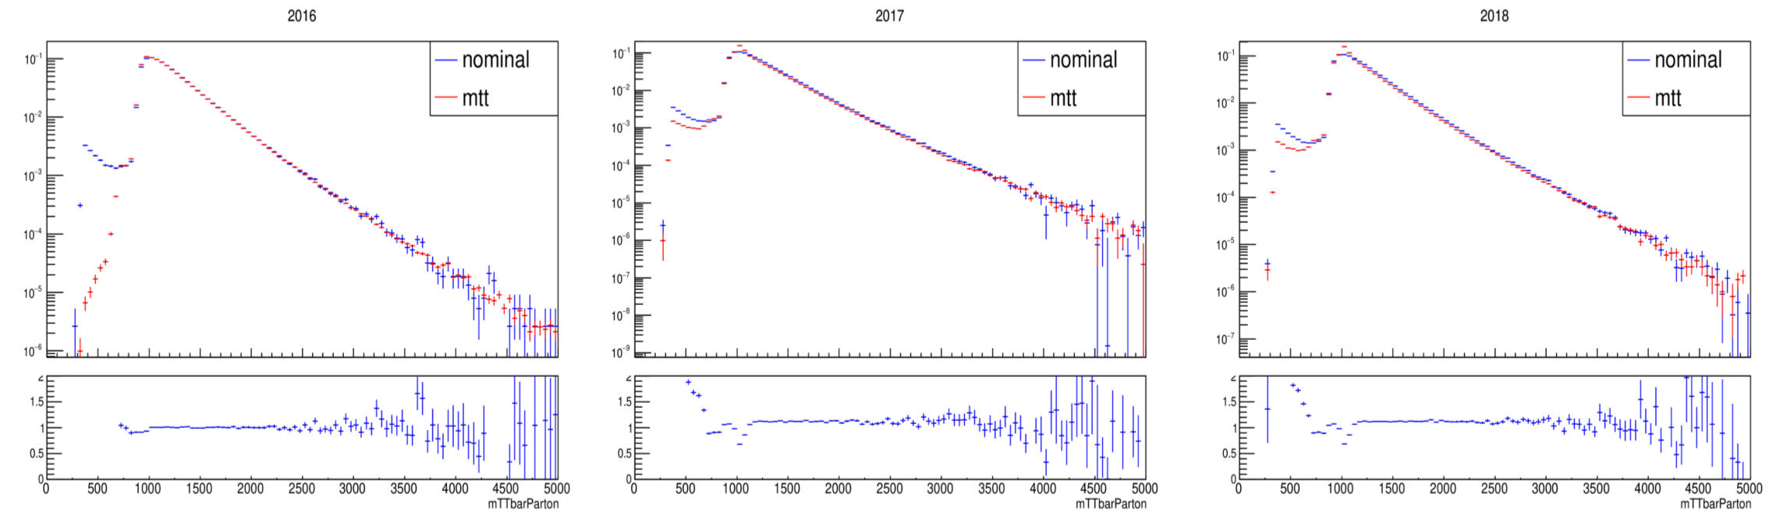
MC Closure Tests Mtt vs Nominal Parton

Slide 10
MC Closure Tests Mtt vs Nominal Parton

Slide 11
MC Closure Tests Mtt vs Nominal Parton

Slide 12
MC Closure Tests Nominal 2017 vs 2018 (shape) per slice

Slide 13
MC Closure Tests Nominal 2017 vs 2018 (shape) per slice

Slide 14
MC Closure Tests Nominal 2017 vs 2018 (shape) per slice

Slide 15
MC Closure Tests Nominal 2016 vs 2017 (shape) per slice

Slide 16
MC Closure Tests Nominal 2016 vs 2017 (shape) per slice

Slide 17
MC Closure Tests Nominal 2016 vs 2017 (shape) per slice

Slide 18
MC Closure Tests Nominal 2017 vs 2018 (shape) per slice Nominal

Slide 19
MC Closure Tests Nominal 2017 vs 2018 (shape) per slice Nominal

Slide 20
MC Closure Tests Nominal 2017 vs 2018 (shape) per slice Nominal

Slide 21
Efficiency from Nominal MC and High Mtt (corrected xsec)

Slide 22
Efficiency from Nominal MC and High Mtt

Slide 23
Efficiency from Nominal MC and high Mtt

Slide 24
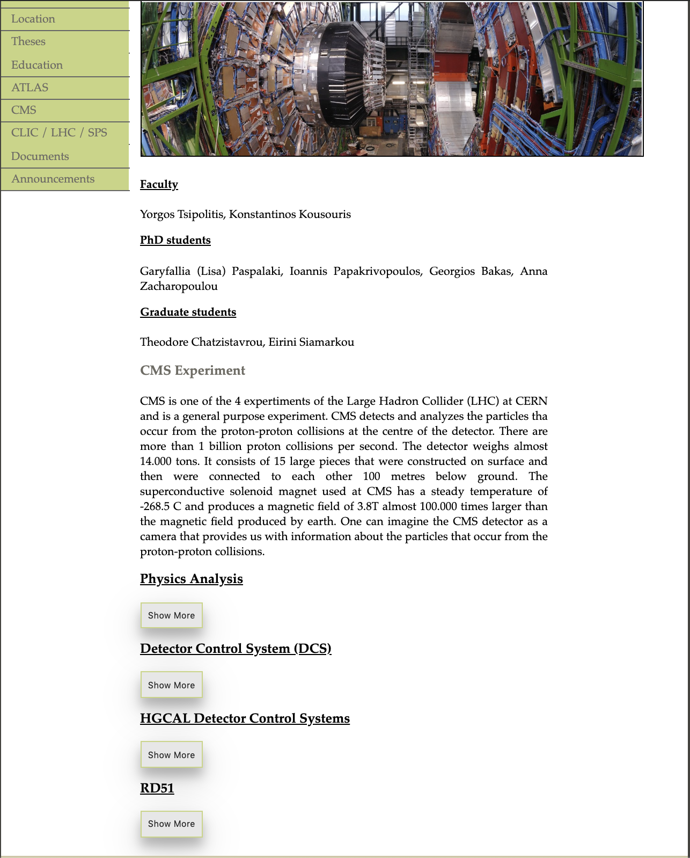
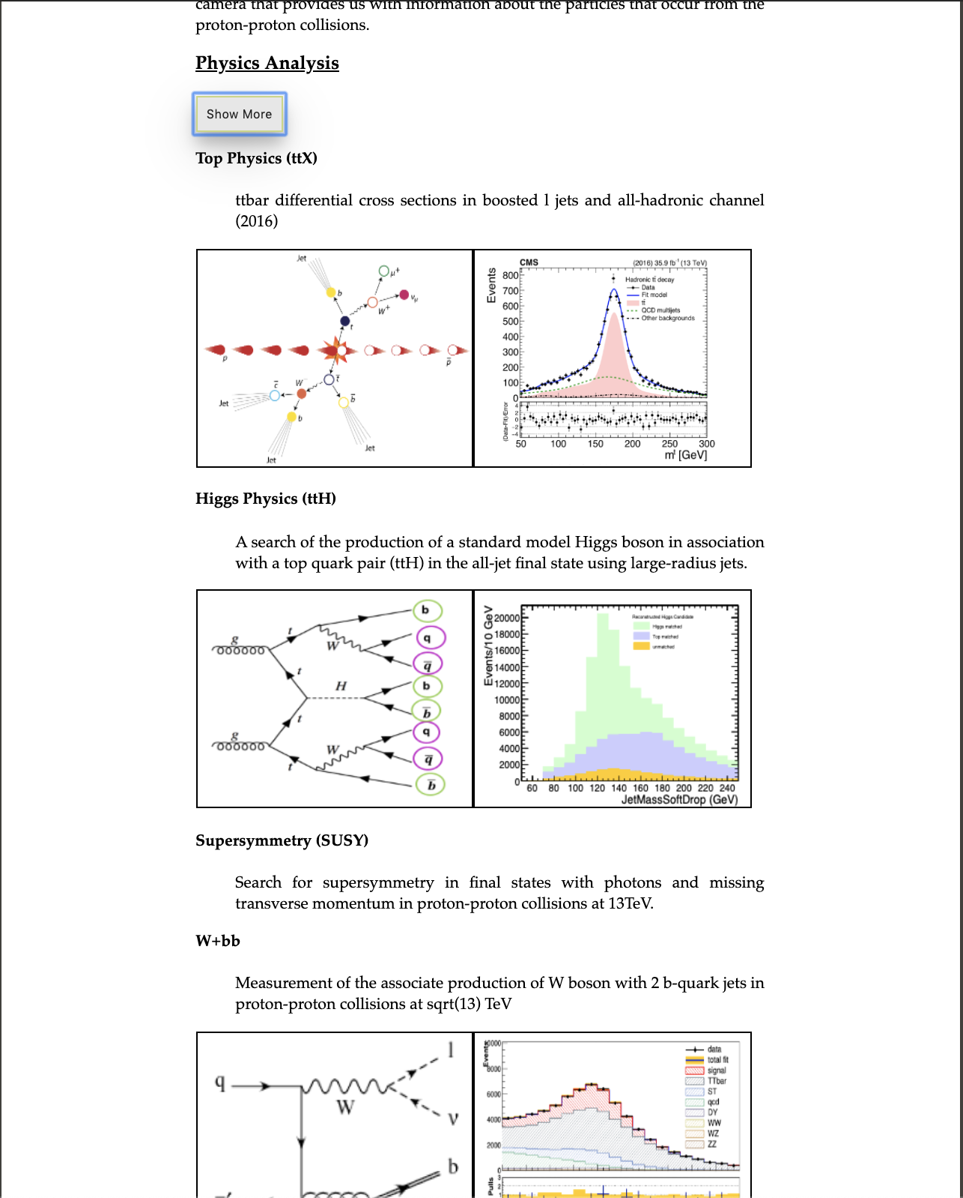
NTUA HEP Site

Slide 25
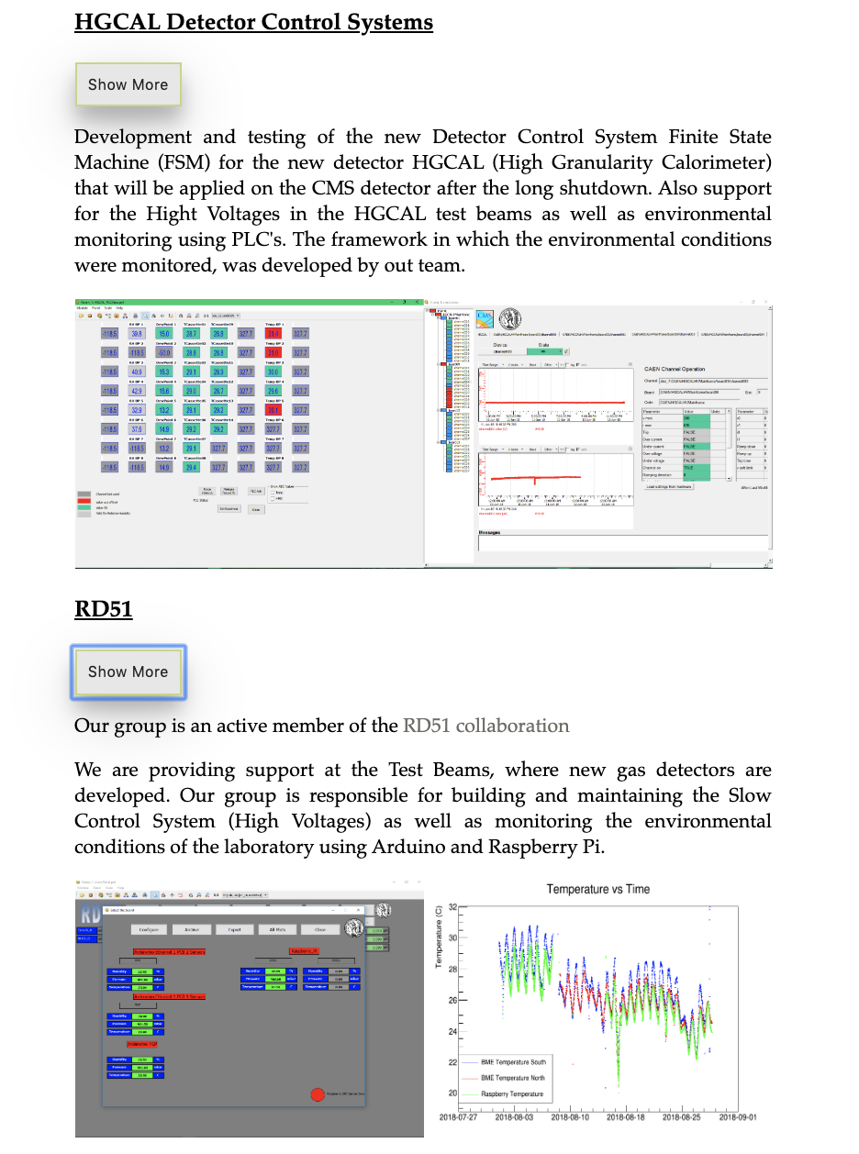
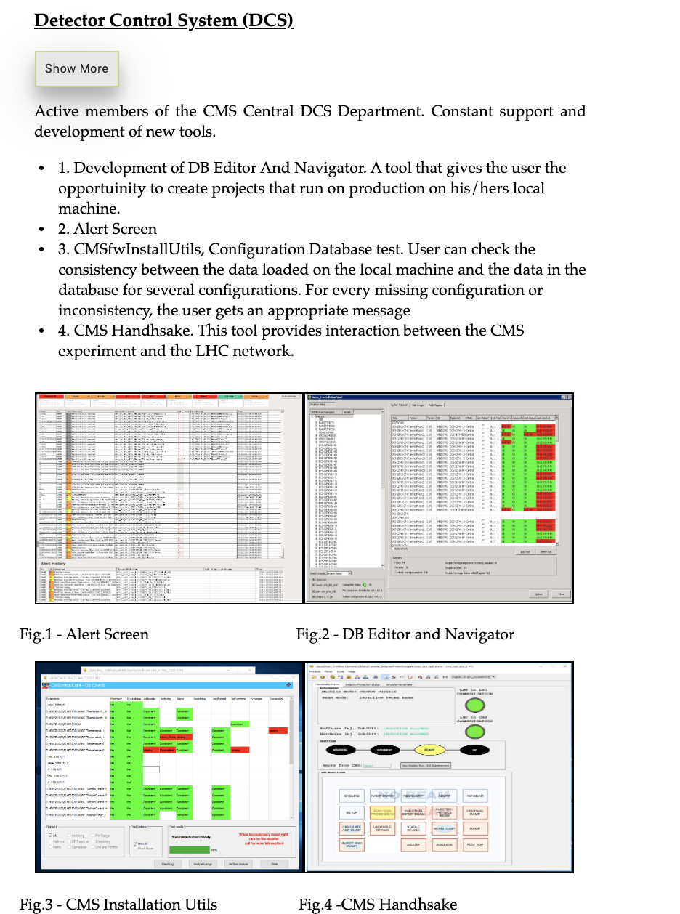
NTUA HEP Site

Slide 26
HEP Data
sadasdas

